Slide 1

Exploratory Data Analysis for Medical Insurance Prediction Analysis of Key Features and Insights

Slide 2

About Me:
e
01
Kumar Raju N
B Com(Gen)
Why you want to learn Data Science
I want to be a detective but instead of that I choose Data Science because, Data science is like being a detective for information. You can gather clues (data) and solve mysteries (problems) by analyzing them closely.

Slide 3
Agenda:
Introduction
Overview and importance of the project.
Business problem and objectives.
Data Overview
Description of the medical cost dataset.
Explanation of features.
Exploratory Data Analysis (EDA)
Visualizations and insights from the data.
Data Preparation and Modeling
Splitting data, preprocessing steps.
Training and evaluating models.
Model Comparison
Evaluation metrics and comparison of models.
Conclusion and Next Steps
Summary of findings and recommendations.

Slide 4
Business Problem:
Health insurance companies need to set premiums that accurately reflect the expected medical costs of their insured population. However, this is challenging because they have limited information about each individual. Traditionally, they have relied on population averages and trends, which can lead to inaccurate estimates for specific groups.
Objective:
Develop a machine learning model that can predict the individual medical costs of a beneficiary based on readily available data points. This will allow the insurance company to:
Set more accurate premiums based on individual risk profiles.
Identify high-risk individuals for targeted preventative healthcare interventions.
Improve resource allocation for different regions or demographics.

Slide 5
Summary:
Dataset includes 1338 entries with no missing values.
Features: age, sex, BMI, children, smoker, region, charges.
Insights:
Diverse age distribution (mean: 39 years).
Wide range of BMI values (mean: 30 kg/m^2).
Varied number of children (mean: 1 child).
Medical charges vary widely (mean: $13,270).
Conduct EDA for deeper insights.
Preprocess data: handle categorical variables, scale numerical features, split data.
Train and evaluate predictive models: KNN, linear regression, SVM, decision trees, random forest.
Select best model based on evaluation metrics.
Deploy selected model for medical cost prediction.

Slide 6




Libraries and Modules Used Used
Pandas: For data manipulation and analysis.
Numpy: For numerical computing and array operations.
Seaborn: For statistical data visualization based on matplotlib.
Matplotlib.pyplot: For data visualization using plots and charts.
sklearn.preprocessing.OneHotEncoder: For one-hot encoding categorical variables.
sklearn.compose.ColumnTransformer: For applying different transformations to different columns
sklearn.pipeline.Pipeline: For creating and managing machine learning pipelines.
sklearn.model_selection.train_test_split: For splitting data into training and testing sets.
sklearn.neighbors.KNeighborsRegressor: For implementing the K-Nearest Neighbors algorithm for regression.
sklearn.linear_model.LinearRegression: For implementing linear regression models.
sklearn.svm.SVR: For implementing Support Vector Machine models for regression.
sklearn.tree.DecisionTreeRegressor: For implementing decision tree models for regression.
sklearn.ensemble.RandomForestRegressor: For implementing random forest models for regression.
sklearn.metrics.mean_absolute_error: For evaluating the performance of regression models using mean absolute error.

Slide 7
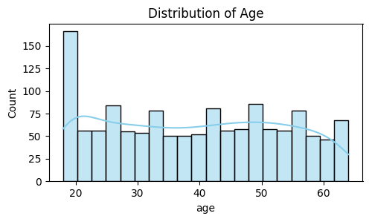
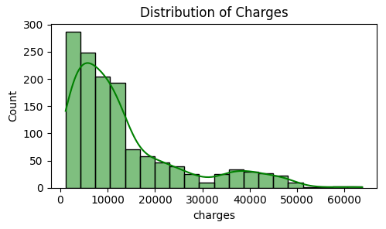
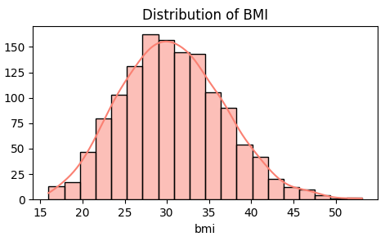
Distribution of Age, BMI & Charges:
Age distribution is roughly bell-shaped, indicating a normal distribution.
BMI distribution is slightly right-skewed, suggesting that there are more individuals with higher BMI values.
Charges distribution is highly right-skewed, implying a significant number of individuals with exceptionally high medical costs.
The presence of outliers in the charges column is evident.

Slide 8
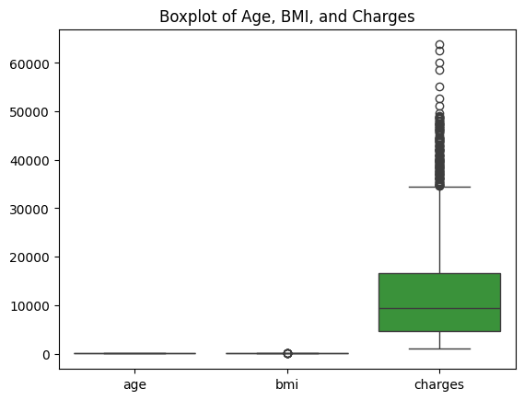
Distribution Plot of Age, BMI & Charges:
Outliers are present in all three variables (age, BMI, and charges).
Age and BMI have relatively smaller interquartile ranges compared to charges.
Charges exhibit a wide range of values, highlighting the significant variability in medical costs.

Slide 9
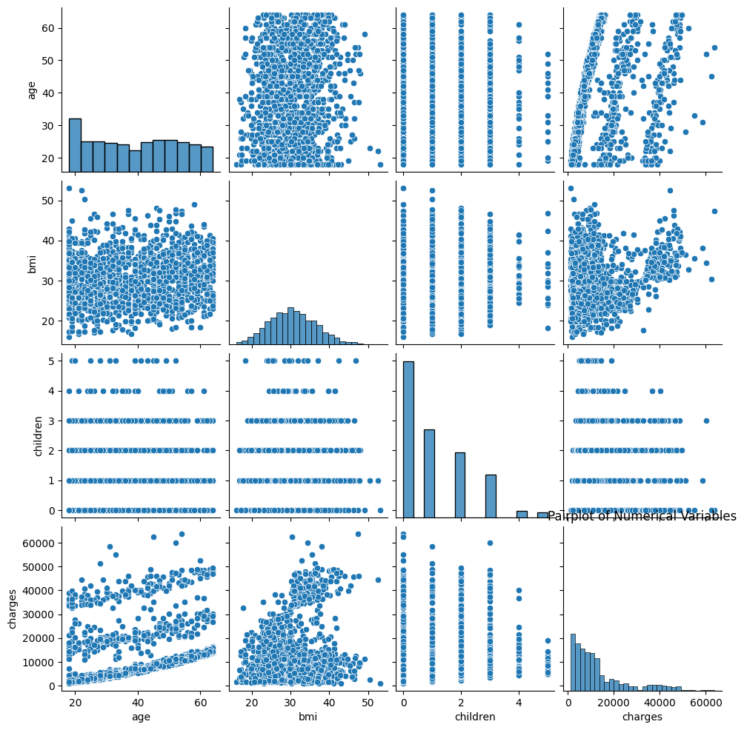
Numerical Variables:
Age vs. BMI:
- No clear correlation observed between age and BMI.
- Individuals of all ages have varying BMI values.
Age vs. Children:
- No apparent relationship between age and number of children.
- Individuals of similar ages can have different numbers of children.
BMI vs. Children:
- No strong association between BMI and number of children.
- Individuals with different BMI values can have similar numbers of children.
Charges vs. Age:
- No clear pattern or correlation observed between charges and age.
- Individuals of all ages can incur high or low medical costs.
Charges vs. BMI:
- No clear correlation between charges and BMI.
- Individuals with varying BMI values can have similar medical charges.
Charges vs. Children:
- No apparent relationship between charges and number of children.
- Individuals with different numbers of children have similar charge distributions.

Slide 10
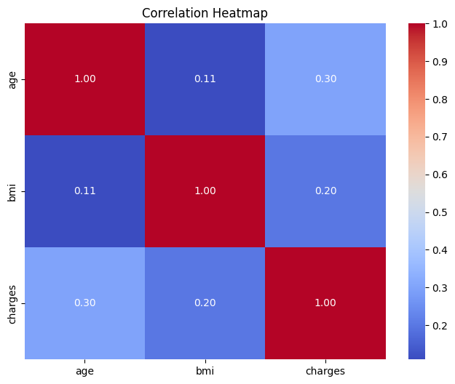
Correlation:
Age and BMI have a weak positive correlation (0.11), indicating a slight tendency for older individuals to have higher BMI values.
Charges have a weak positive correlation with age (0.30) and BMI (0.20), suggesting that older individuals and those with higher BMI tend to have slightly higher medical costs, on average.
However, it's important to note that these correlations are relatively weak, indicating that age and BMI alone cannot reliably predict medical charges.
The heatmap visually highlights the lack of strong correlations between the variables, reinforcing the need for further analysis and exploration to identify potential predictors of medical costs.

Slide 11
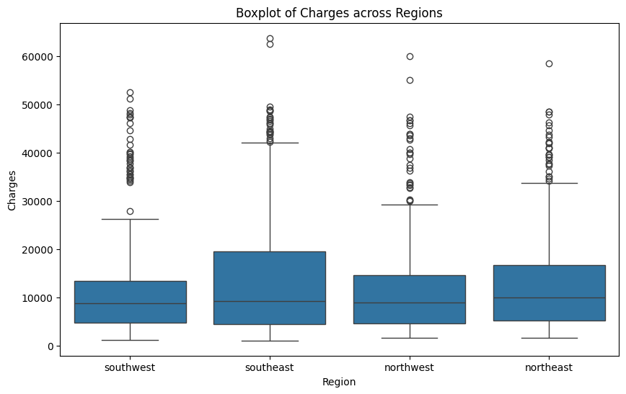
Charges across Regions:
There are significant differences in charges across different regions.
The median charges are highest in the southeast region and lowest in the southwest region.
The southeast region has a wider range of charges compared to other regions, indicating greater variability in medical costs.
Outliers are present in all regions, suggesting the existence of individuals with exceptionally high charges.

Slide 12
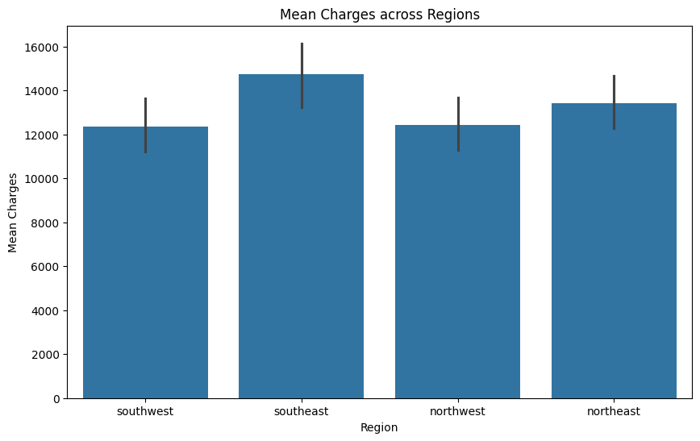
Mean Charges across Regions:
The mean charges vary significantly across different regions.
The southeast region has the highest mean charges, followed by the northeast and northwest regions.
The southwest region has the lowest mean charges.
This barplot provides a clear visualization of the average medical costs associated with each region.

Slide 13
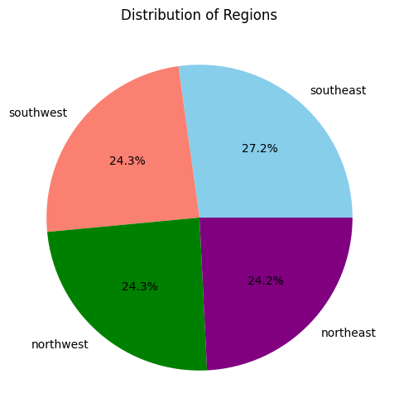
Distribution of Regions:
The southeast region has the highest proportion of individuals (27.2%), followed by the southwest (24.3%), northeast (24.2%), and northwest (24.3%).
The distribution of individuals across regions is relatively balanced, with no region dominating the dataset.

Slide 14
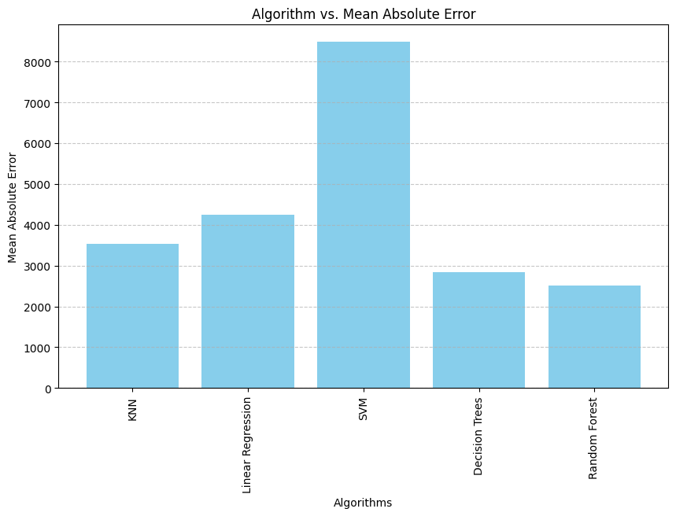
Comparison of Mean Absolute Error:
**Algorithm with the Lowest Mean Absolute Error:**
- The plot indicates that the Random Forest algorithm achieved the lowest Mean Absolute Error (MAE) score, implying that it outperformed other algorithms in predicting medical costs.
**Relative Performance of Algorithms:**
- KNN and Linear Regression exhibited relatively higher MAE scores compared to other algorithms, suggesting that they might not be as accurate for this specific task.
- SVM and Decision Trees demonstrated moderate performance, with MAE scores higher than Random Forest but lower than KNN and Linear Regression.

Slide 15
Conclusion :
The Random Forest algorithm outperformed other machine learning algorithms in predicting medical costs, as evidenced by its lowest Mean Absolute Error (MAE) score. This suggests that Random Forest is the preferred choice for this specific task. Further investigation and hyperparameter tuning of the Random Forest model could potentially lead to even better predictions.

Slide 16

THANK YOU

